Slide 1
Hyperparameter Database Group : DB-03 Name: Tejas Patil, Yash Jain

Slide 2
Dataset Description
Name: Indian Liver Patient record
Type of dataset: csv
Attributes: Age, Gender, Total_Bilirubin, Direct_Bilirubin, Alkaline_Phosphotase, Alamine_Aminotransferase, Aspartate_Aminotransferase, Total_Protiens, Albumin_and_Globulin_Ratio, Dataset
No of records: 583
No of columns: 10

Slide 3
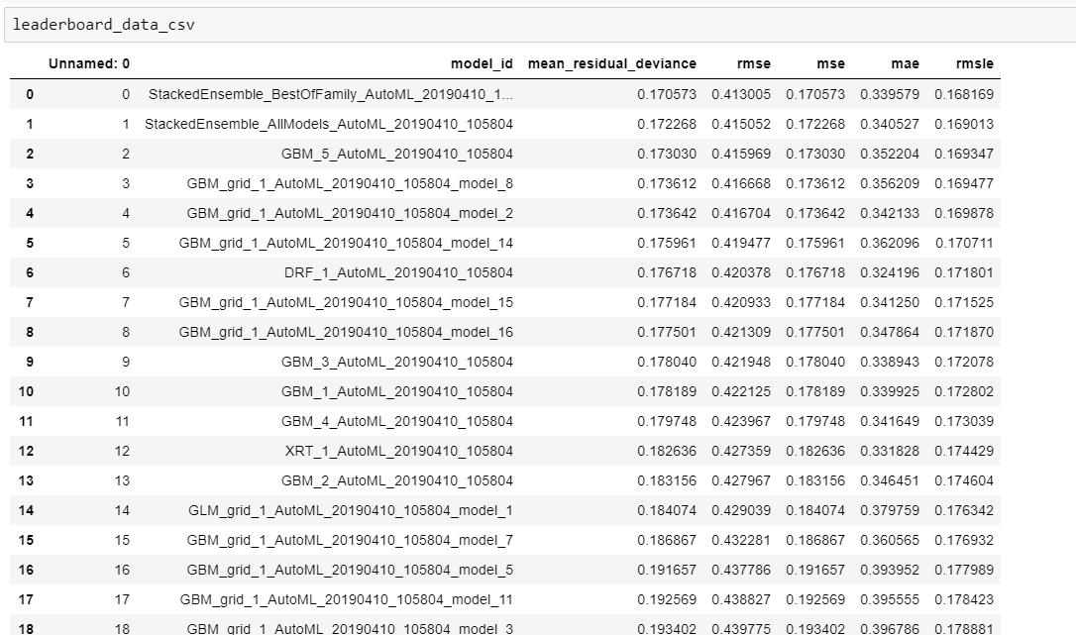

Slide 4
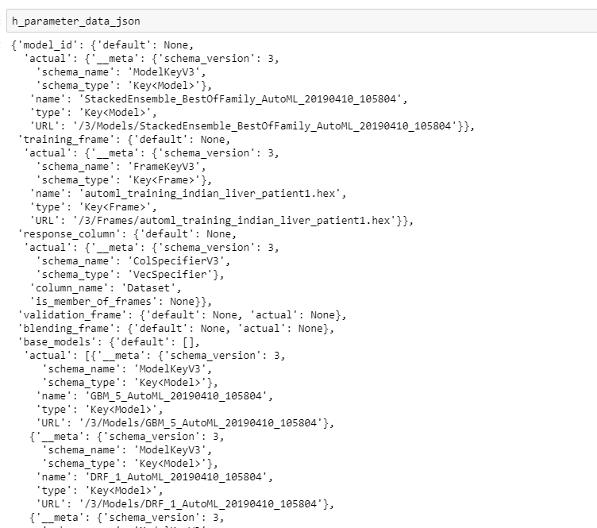

Slide 5
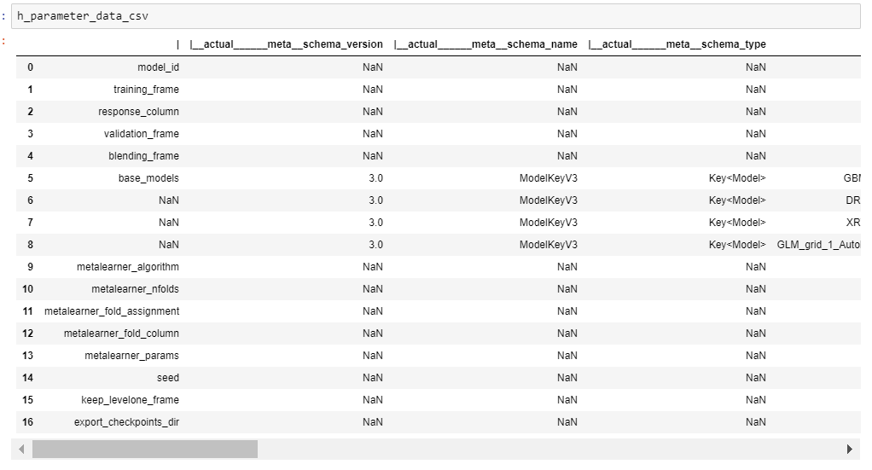

Slide 6
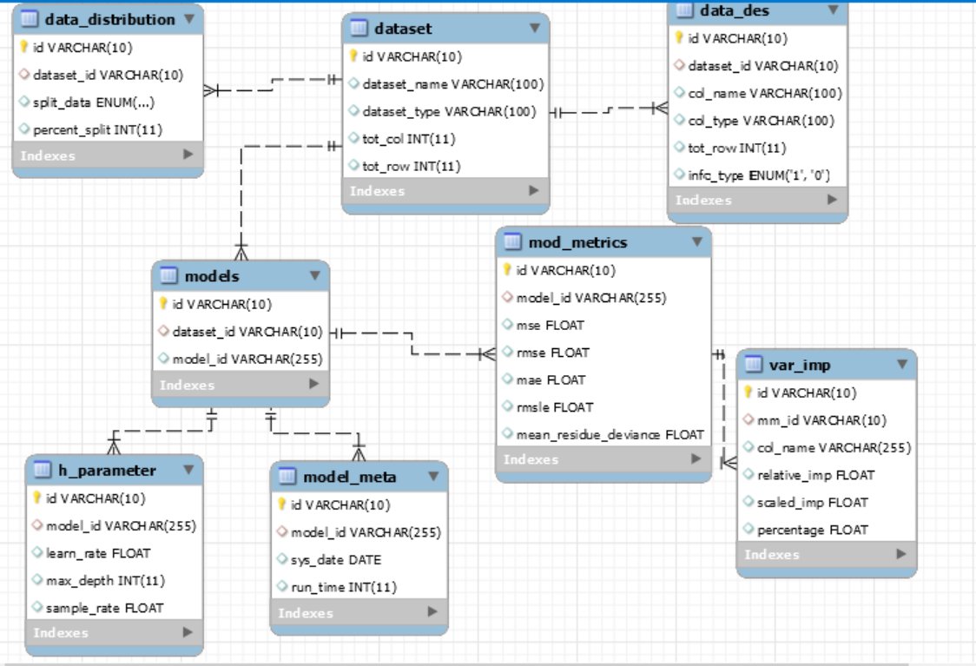

Slide 7
Project Progress
Completed
1. SQL – ERD.
2. Data – From the DS team we have received JSON and CSV files of the best model generated from H20 AutoML
Pending
1. SQL – populating the database, ensuring anomalies aren’t present, creating procedures, functions, views, use cases; Same for 2nd dataset
2.Data – Remaining JSON and CSV files of all the models from the dataset; same for 2nd dataset.

